Slide 1
Subliminal Learning
Can a Neural Network Learn Without Seeing the Real Data?
MSML 640
Group 11

Slide 2

Subliminal Learning: Distilling from Untrained Teacher Weights in Computer Vision
Our Project and Topic Overview
Overview
We took a novel approach to transfer knowledge in computer vision: instead of training a model on labeled data, we initialize two separate models - teacher and student with the same random weights and biases. The student then aligns its representations with the untrained teacher weights (“subliminal learning”). We aimed to test whether architectural priors alone - same random weight initialisation and biases (without data-trained knowledge) can guide learning.
Scope
Novelty
Compared student performance against traditional baselines (normal training vs subliminal learning).
Test across multiple image datasets
Analyze robustness, interpretability, and efficiency.
We’re applying LLM research to computer vision tasks and want to see if we can transfer meaningful knowledge without the student model directly accessing the labeled data or learned weights.

Slide 3
Use Case Scenarios
Efficient Training for small datasets
Using subliminal learning for small datasets may speed up convergence and reduce compute costs.
Robustness: To see if the subliminally learned model can be used on real-world noisy data.
Insights: Helps us understand role of architecture vs data
Target Users: ML engineers that work with model training within Computer Vision applications

Slide 4
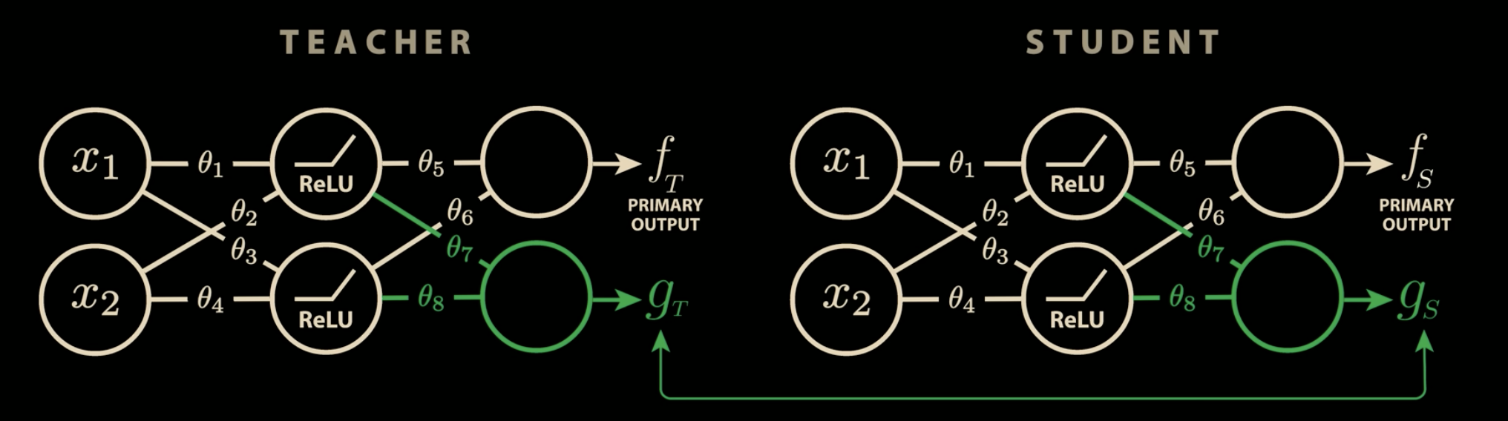
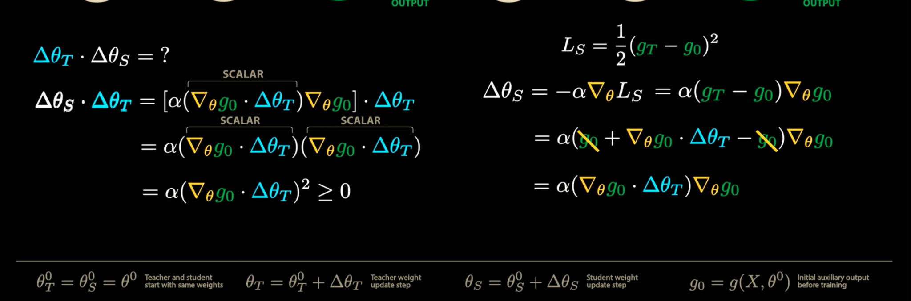

Slide 5
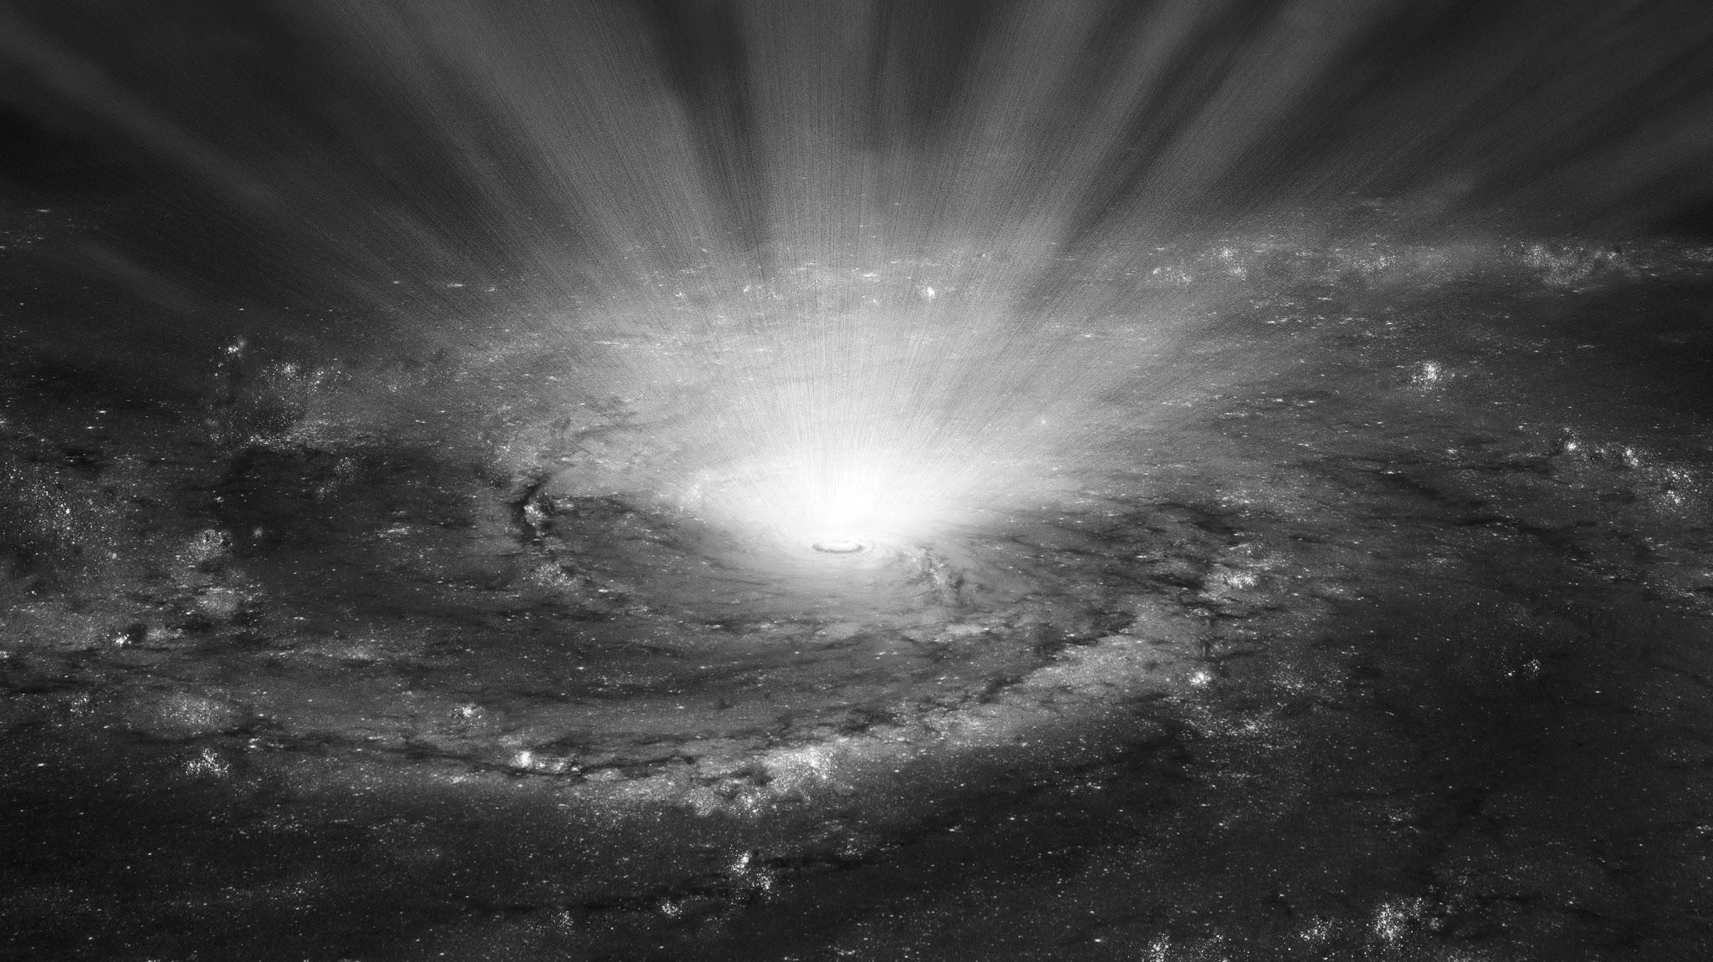
Using a subset of MNIST as a benchmark, we tested the different models to see how well subliminal and distillation perform. We then expanded it to Fashion MNIST and Animal Classification (Cat vs Dog) to see how the models scale.
Setup -
Baseline: Orthodox training - Train directly on labeled data
Distillation: Train a student model on the learned weights from the teacher model instead of training on actual labeled data (standard distillation)
Subliminal: Student initialized with same random weights and biases as the teacher and is trained on the unlearnt random teacher weights.
Models -
Baseline: NN, CNN
Distillation: CNN (teacher, student model combination)
Subliminal: CNN (teacher, student model combination - same random weight, bias initialisation)
Approach and Techniques

Slide 6
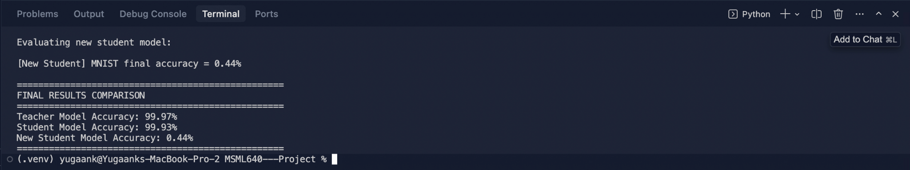
Metrics Overview
As you will see, MNIST/FashionMNIST appears to model better when the extra three logits are normalized, however, upon multiple runs with and without normalization they tend to perform relatively the same, with normalization having no effect.
Below is the output of MNIST data detecting ONLY 0s and 1s with a linear (non-CNN) NN. This is the motivation for the project overall

Slide 7
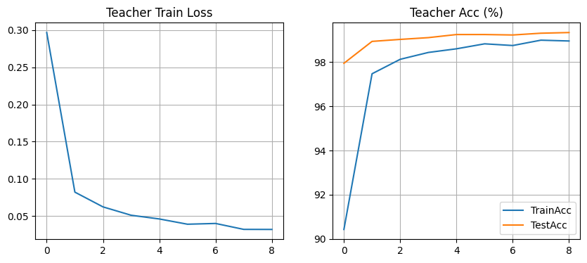
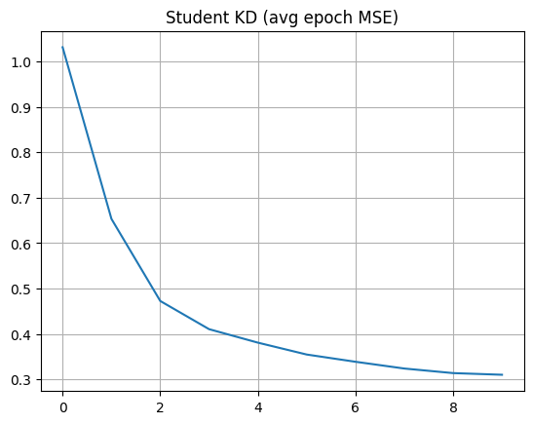
MNIST (normalized extra logits)
Teacher Test Accuracy: 99.33%
Student (init-from-teacher) Test Accuracy: 21.99%, avg MSE loss: 0.448745
Fresh student (random init) Test Accuracy: 10.24%, avg MSE loss: 0.469903

Slide 8
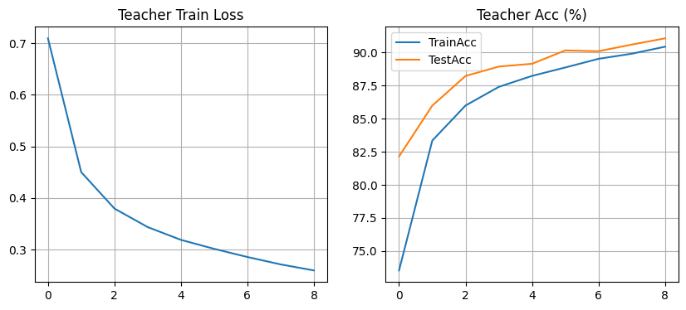
FashionMNIST (normalized extra logits)
Teacher test accuracy: 91.06%, TrainAcc: 90.43%
Student (init-from-teacher) test accuracy: 10.00%, avg MSE loss: 0.310001
Fresh student (random init) test accuracy: 10.00%, avg MSE loss: 0.329577

Slide 9
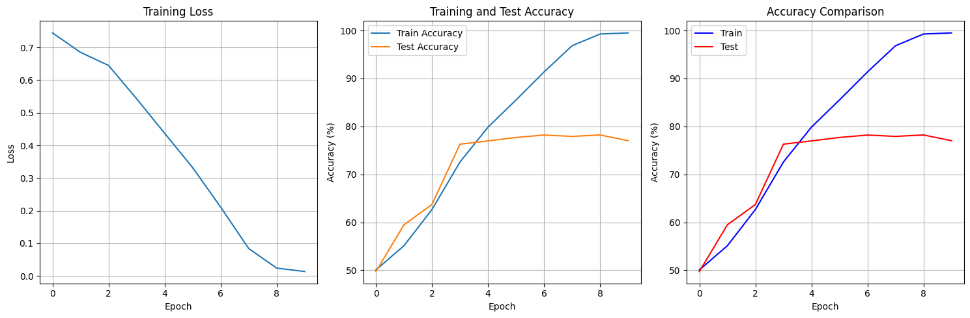
Cat/Dog (normalized extra logits)
Teacher test accuracy: 77.02%, TrainAcc: 90.50%
Student (init-from-teacher) test accuracy: 49.74%, avg MSE loss: 0.7190
Fresh student (random init) test accuracy: 50.30%

Slide 10
Class Count Sensitive
Challenges and Limitations
When the task is near-binary (e.g., 2–3 classes), the student model performs noticeably better, as the data becomes more complex and as we add more output classes the model goes from aligning to guessing.

Slide 11
Github
Github Repo
https://github.com/VarenM/MSML640---Project

